Slide 1
Council for the Alaska Micro-reactor Program (CAMP)
19 MAR 2025
UNCLASSIFIED

Slide 2
Agenda
Opening Remarks & Pilot Status
DAF Advanced Nuclear Energy Update
Pilot Status & Progress
News & Updates
DAF Advanced Nuclear Energy Deployment Strategy
UAF – Nuclear Energy Feasibility in Nome, AK
INL – Industry Update for Scaling Advanced Nuclear Technology
Project Partner & Stakeholder Updates
Closing Remarks
UNCLASSIFIED

Slide 3
Opening remarks
Ms. Nancy Balkus
Deputy Assistant Secretary of the Air Force
(Infrastructure, Energy, and Environment)
UNCLASSIFIED

Slide 4
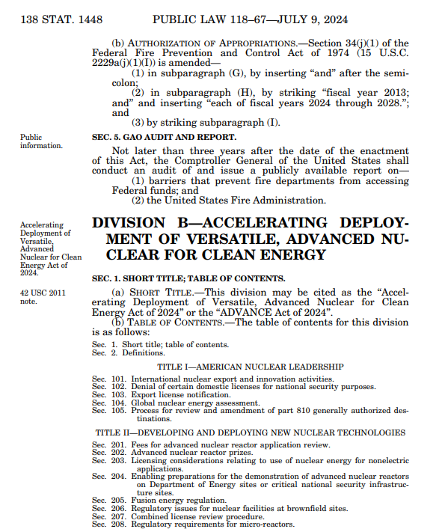
News & Updates
Bipartisan Support for ADVANCE Act of 2024
Continued DAF Collaboration
ADEC workshop
NRC workshops
Conferences
Political engagements (e.g. White House Office of Science and Technology)
Administration Change (new Executive Orders)
ADVANCE Act: Accelerating Deployment of Versatile Advanced Nuclear for Clean Energy Act of 2024

Slide 5
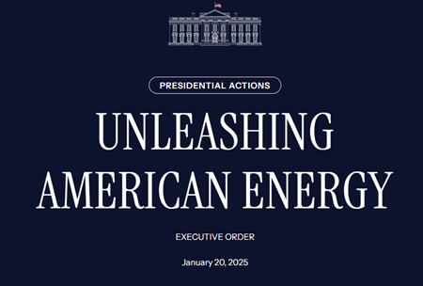
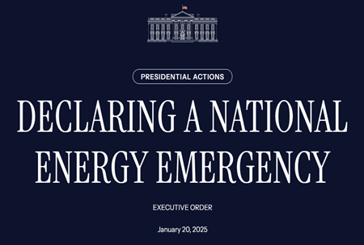
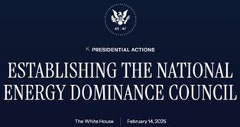
News & Updates
EO 14154: Unleashing American Energy
EO 14156: Declaring A National Energy Emergency
EO 14213: Establishing the National Energy Dominance Council
EO 14153: Unleashing Alaska's Extraordinary Resource Potential
DAF is conducting due diligence to assess new Executive Orders' (EOs) potential to unlock new possibilities
Several EOs seek expedited permitting processes related to energy and natural resources
New requirements could lead to adjustments within NRC licensing to support advanced nuclear reactors
Bipartisan support for advanced nuclear energy technologies expected to continue

Slide 6
Advanced Nuclear Strategy & Eielson AFB
Strategy uses technology-agnostic approach to meet mission resilience requirements and NEPA compliance
Eielson pilot is the pathfinder for Enterprise deployment
Pilot is currently in proposal review
SAF/IEE Memo: Pathways to Advanced Nuclear Energy at DAF Installations Initiates DAF framework for advanced nuclear energy siting
3 Ps: Your partnership remains crucial for successful pilot and pathfinder development

Slide 7
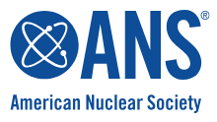
Eielson AFB Micro-Reactor Pilot Program Status
JAN 2023
AUG 2023
2025
RFP Closed
DAF Selects/ Rescinds Owner/Operator
DAF issued the Notice of Intent to Award for a micro-reactor facility at Eielson AFB.
Vendor Selection & Pre-Licensing Process Initiated Project planning to inform siting and environmental activities begins.
Where DAF has been since August 2024 CAMP
Aug 24: Nuclear Regulatory Commission (NRC) Memorandum of Understanding (MOU) Addendum
Oct 24: Frontiers Project
Nov 24: Fission for the Future
Nov 24: American Nuclear Society
Nov 24: Alaska Department of Environmental Conservation (ADEC) Workshop
Jan 25: Integrated Strategy Group (Base Town Hall)
Mar 25: NRC Annual Conference
Mar 25: Tanana Chiefs Conference (TCC) Convention
AUG 2023
SEP 2023
Public Town Hall
The inaugural town hall included a panel of speakers from DAF, NRC, and INL, and was moderated by University of Alaska-Fairbanks representatives.
Acquisition Process Halted
Protest filing temporarily halts acquisition process.
*The proposed timeline is tentative
and subject to change.
BLUE: Procurement Actions
PURPLE: Partner and Stakeholder Engagement
PINK: Licensing, Siting, and Operation
For more information, please visit: https://www.Eielson/af.mil/microreactor/
Notes:
Department of Air Force
Nuclear Regulatory Commission
Defense Logistics Agency – Energy
Department of Energy
Idaho National Lab
Pacific Northwest National Lab
Tanana Chiefs Conference
State of Alaska
Alaska Department of Environmental Conservation
City of North Pole
City of Fairbanks
City of Fairbanks North Star Borough
University of Alaska

Slide 8
DAF Advanced Nuclear Energy Program
BLUF: DAF is exploring advanced nuclear energy capabilities to support its mission-critical infrastructure through several ongoing efforts
Eielson Micro-reactor Pilot
Pacific Northwest National Laboratory (PNNL) Partnership
Defense Innovation Unit (DIU) Advanced Nuclear Power for Installations (ANPI) Partnership
AFWERX Simulation
DoD Advanced Reactor Criteria for Baseline Understanding of Enterprise Scalability (DARC BLUES)
DAF Advanced Nuclear Energy Program
Notes:
DIU ANPI – Army and DAF seeking a novel approach using recent advances in the nuclear industry that can provide continuous/reliable power regardless of weather conditions to 1) maintain military mission continuity and 2) comply with Congressional mandate under the 2021 National Defense Authorization Act to provide its critical missions with a goal of 99.9 percent reliable energy by 2030.
DARC BLUES – DoD Advanced Reactor Criteria and Baseline Understanding for Enterprise Scaling (DARC BLUES), a FRAMEWORK which will use advanced data analytics to validate nuclear energy requirements and technologies and enhance programmatic decision-making as projects move through the governance process. We expect DARC BLUES to be implemented by 2027
PNNL – comprehensive understanding of the socio-economic and environmental factors influencing the Fairbanks North Star Borough population's interest in innovative nuclear energy technologies
AFWERX – Hill AFB: Radiant Industries is conducting Kaleidos micro-reactor modeling and simulation of use case scenarios at Hill AFB through an AFWERX SBIR (Small Business Innovation Research) award.
JBSA – MOU between JBSA and City of San Antonio, Utilitry Provider CPS Energy and SAF/IEE: first-of-a-kind MOU (memorandum of understanding) to explore long lead time sources of resilient electricity to include potential new nuclear energy technologies

Slide 9
Advanced Reactor Deployment Strategy
Match technology to mission
Determine where to go next, size and scale
Determine how to fund
Collaborate with Federal Partners
DOE (fuel)
NRC (licensing)
Graphic courtesy of Pacific Northwest National Laboratory
Develop a data-driven decision-making for technical oversight and enabling sound investments
Notes:
The DAF employs a technology-agnostic approach towards energy resilience projects, ensuring that each installation is paired with a technology that will best meet unique installation and community needs and limitations, utilizing both inside and outside fence line data sets.
You may discover that advanced nuclear technology might not be the optimal solution to support installation-specific needs!
DAF is leveraging the Eielson Micro-reactor Pilot Program to explore all aspects related to micro-reactor deployment, including procurement, leasing, contracting, licensing, siting, safety review, environmental review, and tribal and public engagement. Throughout the process, DAF will be reviewing the economic, environmental, social and safety factors associated with implementing micro-reactors for installation energy resilience. The outcomes of the Eielson Micro-reactor Pilot Program will determine future scalability.
DAF is restraining from attempting additional micro-reactor projects until the Eielson Micro-reactor Pilot Program is completed and viability is determined. Trial before widespread error!
The DAF will continue to seek third-party funding acquisition methods to support its missions. The DAF does not seek to own, operate, or maintain advanced nuclear systems; however, other third-party acquisition methods should be explored through framework development and business case analysis simulations.
Additionally, the DAF will seek deeper relationships with federal partners, to include the Department of Energy to plan for future fuel needs and prioritization of requirements across the Enterprise.
As part of this, we are establishing a data-driven framework and nuclear energy siting system, named DoD Advanced Reactor Criteria and Baseline Understanding for Enterprise Scaling (DARC BLUES), which will use advanced data analytics to validate nuclear energy requirements and technologies and enhance programmatic decision-making as projects move through the governance process.
The DAF’s advanced nuclear study previously mentioned will seek to identify both stringent criteria and processes to integrate data and develop metrics to produce an analytic architecture and tool, allowing information to be more aligned to DoD’s Data Strategy VAULTIS - Visible, Accessible, Understandable, Linked, Trustworthy, Secure, and Interoperable, Secure. Interoperability with and subsequent achievement of Authority to Operate (ATO) on a centralized DoD platform (Advana), will be critical to the data integrity, governance, data accessibility, and cybersecurity of the future tool.
DAF advanced nuclear energy projects will be licensed by the NRC – early and often engagement is necessary to understand requirements and avoid downstream delays.
The NRC is developing opportunities to streamline the regulatory process without compromising the high standards of safety review, a key priority DAF shares. This will take time, but we can start understanding the process now.

Slide 10
Nuclear Energy Feasibility in Nome, AK

Slide 11
Industry update for scaling advanced nuclear technology

Slide 12
March 2025
Brian M. Smith
Director, Nuclear Reactor Development
Idaho National Laboratory
Nuclear Industry Update
Council for the Alaska Microreactor Program

Slide 13
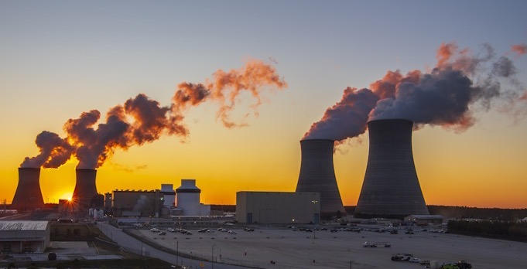
Vogtle Units 3 & 4 are Producing Clean, Reliable, Economic Power
Notes:
https://www.world-nuclear-news.org/Articles/Commercial-operation-marks-completion-of-Vogtle-ex

Slide 14
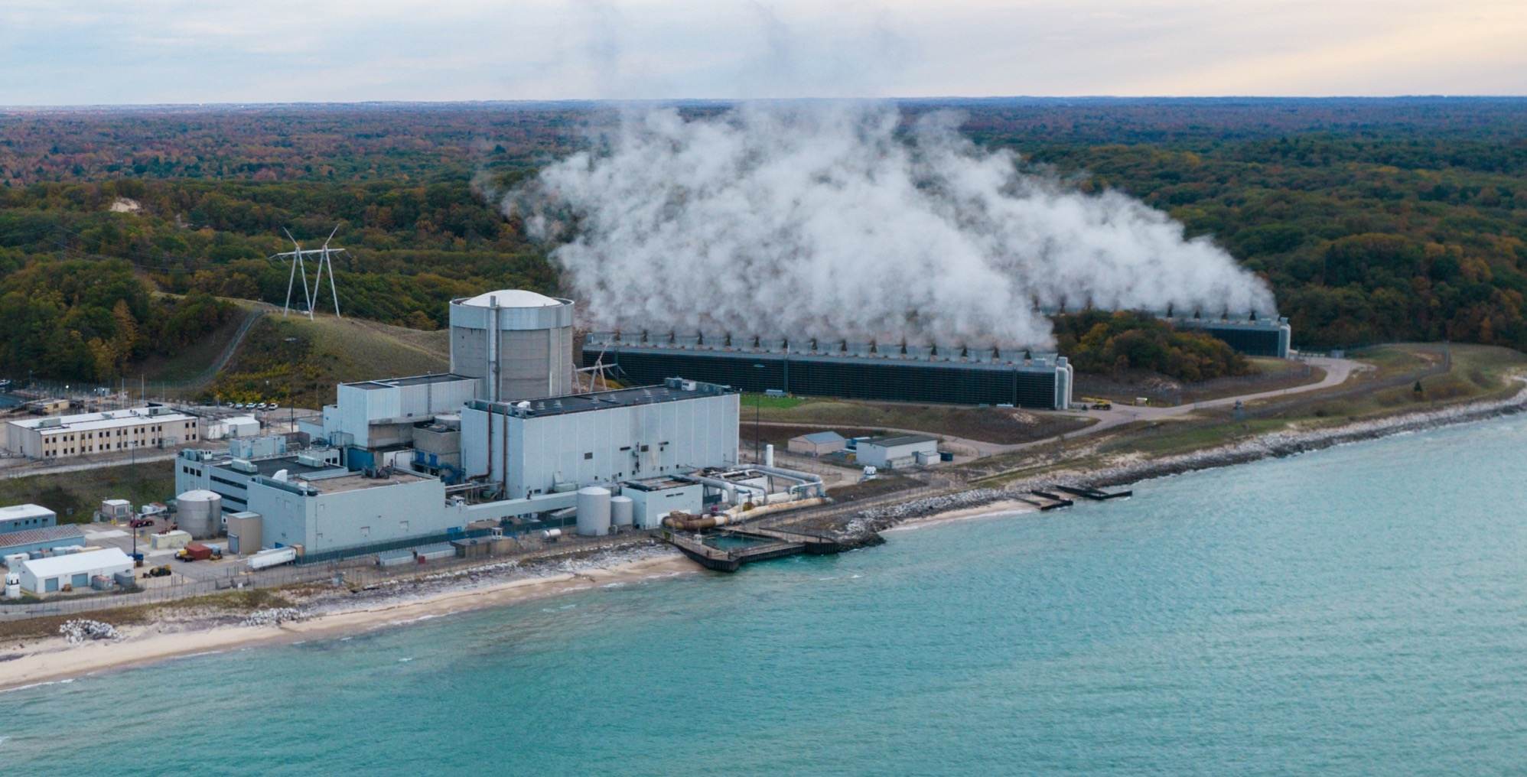
Palisades Restart
advanced by $1.5B from the DOE Loan Program
Office
Notes:
https://world-nuclear-news.org/articles/palisades-on-schedule-for-repowering-nrc-considers-restart-regulations
https://holtecinternational.com/products-and-services/holtec-palisades/
https://www.utilitydive.com/news/doe-usda-announce-nearly-3b-for-palisades-restart/728538/
Holtec International will receive a loan guarantee of up to $1.52 billion from the U.S. Department of Energy’s Loan Programs Office to restart operations at the 800-MW Palisades nuclear generating station in southwestern Michigan, the Biden-Harris administration said Monday.
Two regional electric cooperatives, Hoosier Energy and Wolverine Power Supply Cooperative, will receive about $1.3 billion from the U.S. Department of Agriculture to partially offset power purchases from the reopened facility, the administration said.
Holtec remains on track to restart Palisades in October 2025, company spokesperson Patrick O’Brien told Utility Dive earlier this month. It would be the first U.S

Slide 15
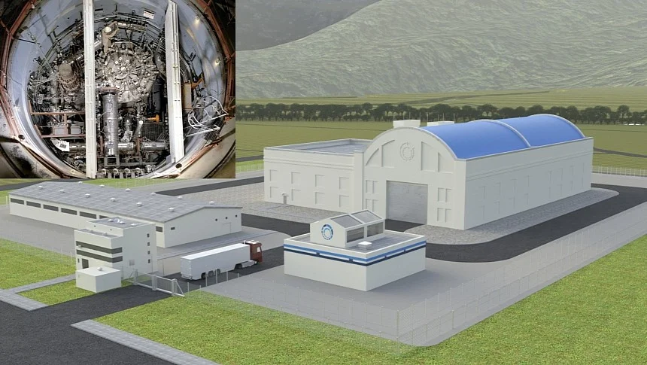
Bipartisan ADVANCE Act Incentivizes and Supports New Nuclear
Notes:
https://s1.cdn.autoevolution.com/images-webp/news/us-nrc-approves-first-molten-salt-reactor-in-50-years-here-s-why-it-s-a-huge-deal-226123-7.jpg.webp

Slide 16
Russian Uranium Ban Unlocks $2.7B for LEU an HALEU Production
Notes:
https://www.energy.gov/ne/articles/russian-uranium-ban-will-speed-development-us-nuclear-fuel-supply-chain

Slide 17
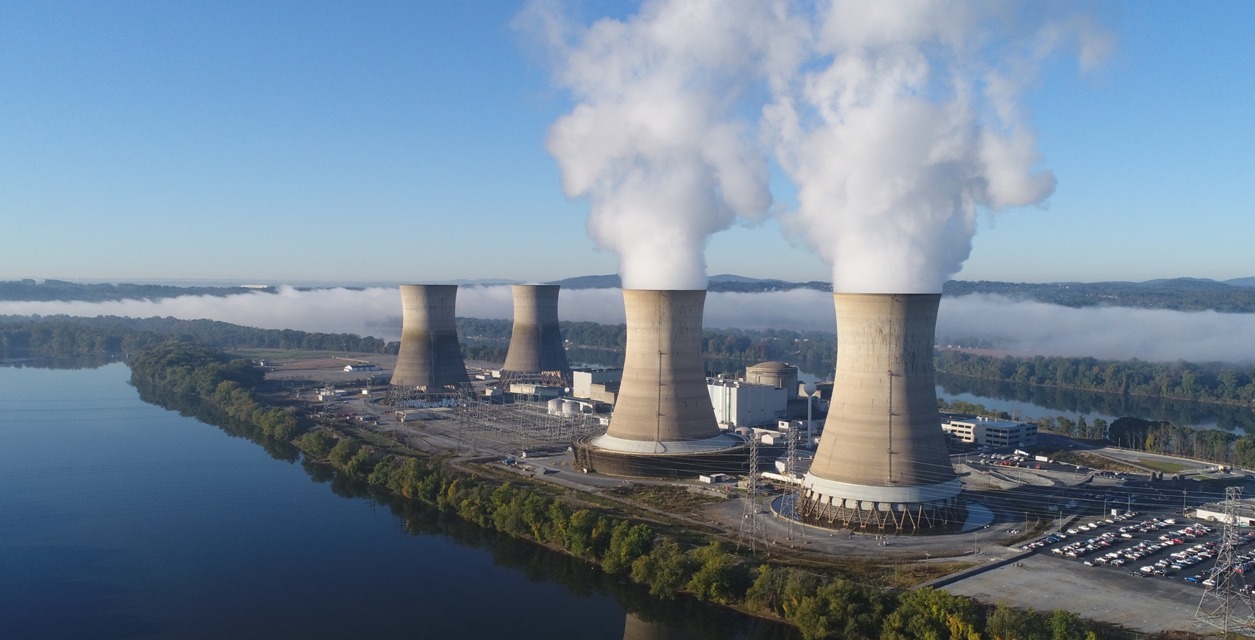
Microsoft Power Purchase Agreement enables the Launch of Crane Clean Energy Center

Slide 18
Oracle Plans to Use 3 SMRs to Power a Gigawatt-Scale Data Center
Notes:
https://www.datacenterdynamics.com/en/news/oracle-to-build-nuclear-smr-powered-gigawatt-data-center/

Slide 19
14 Major Global Banks and Financial Institutions Pledge Support for Nuclear Power
Notes:
https://world-nuclear.org/news-and-media/press-statements/14-major-global-banks-and-financial-institutions-express-support-to-triple-nuclear-energy-by-2050-23-september-2024

Slide 20
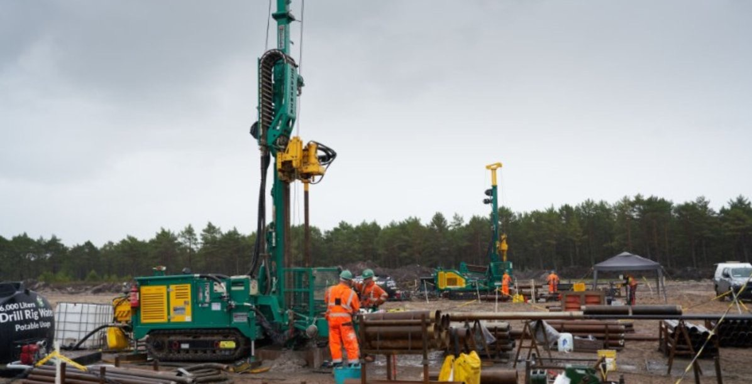
Poland announces $16B Investment it its first nuclear plant
Notes:
https://www.newsweek.com/nato-member-announces-16-billion-investment-first-nuclear-power-plant-poland-1959135
09/25/2024: The Polish government is investing the equivalent of nearly $16 billion to fund the Eastern European nation's first nuclear power plant.
The project team at the Choczewo commune site in Pomerania working on in-depth geological surveys to help advance project planning. The new facility will be Poland's first nuclear power plant. Bechtel

Slide 21
Updated Liftoff Report Reflects Increased Commercialization Momentum
Notes:
https://liftoff.energy.gov/advanced-nuclear/

Slide 22
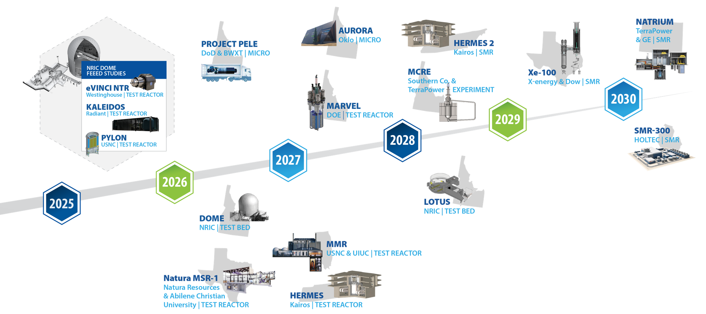
Accelerating advanced reactor demonstration and deployment
Notes:
22-GA50114-R89_FEED*
Criteria for timeline inclusion: Reactors that can meet any 3 of the following 4 criteria should be included on the timeline
• The company is part of a cost sharing government award with a reactor as the direct outcome of that cost share project • There is an identified and concurred on site (note necessarily a site permit or agreement, but a clearly identified site that both the company and the site location acknowledge as the site) • There is an NRC regulatory engagement plan or similarly robust level of pre-licensing engagement with the NRC (minimum is the formal submission of something) • INL engagement of some sort or an agreement with another National Lab Notes: Inclusion in the timeline is limited to reactors to be sited in the United States Timeline dates are those publicly identified by the individual companies
MARVEL – 100 kWth, 20kWe
Pele – 5 MWth, 1 MWe
Aurora – 4 MWth, 1.5 Mwe (but Oklo may be re-branding to their larger version)
MCRE – 150 kWth (not generating energy)Xe-100 – each module 80 Mwe (can be scaled to a ‘four-pack’ up to 320 MWe)
VOYGR – each module 77 Mwe (up to 12 modules, so up to 924 MWe)
SMR-160 – 525 MWth, 160 MWe
Natrium – 840 MWth, 345 Mwe (variable output (up to 500 Mwe short-term with molten salt storage)

Slide 23
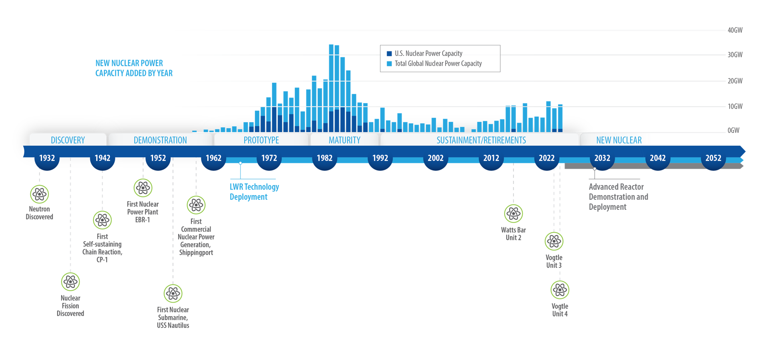
The history of nuclear power, up to now
Notes:
23-50477-R14b_Nuclear_History_Timeline*
Source: https://www.spglobal.com/marketintelligence/en/news-insights/latest-news-headlines/new-build-nuclear-must-face-down-industry-s-costly-past-72854285

Slide 24
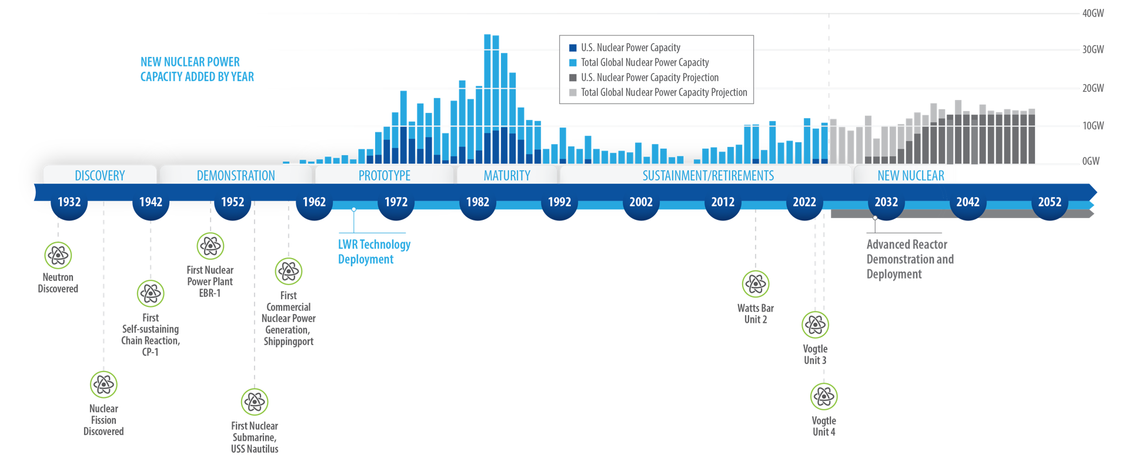
The future of nuclear power is rapidly increased deployment in the U.S. and abroad to meet market demand
Notes:
23-50477-R14a_Nuclear_History_Timeline*
Source: https://www.spglobal.com/marketintelligence/en/news-insights/latest-news-headlines/new-build-nuclear-must-face-down-industry-s-costly-past-72854285
All global capacity including US) additions 1960- present plus projection to 2050: https://www.spglobal.com/marketintelligence/en/news-insights/latest-news-headlines/new-build-nuclear-must-face-down-industry-s-costly-past-72854285
U.S capacity: 1970-2023: https://www.eia.gov/todayinenergy/detail.php?id=57280
US capacity prior to 1960: https://www.eia.gov/todayinenergy/detail.php?id=30972
US projected capacity: https://liftoff.energy.gov/advanced-nuclear/

Slide 25
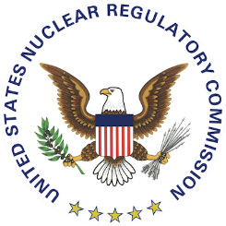
Partner Information Sharing
Roundtable Partner Updates: Eielson AFB
UNCLASSIFIED

Slide 26
Partner Information Sharing
Roundtable Partner Updates: DLA
UNCLASSIFIED

Slide 27
Partner Information Sharing
Roundtable Partner Updates: DOE
UNCLASSIFIED

Slide 28
Partner Information Sharing
Roundtable Partner Updates: INL
UNCLASSIFIED

Slide 29
Partner Information Sharing
Roundtable Partner Updates: NRC
UNCLASSIFIED

Slide 30
Updates and Discussion
UNCLASSIFIED

Slide 31
Local Leadership Update
Tanana Chiefs Conference
UNCLASSIFIED

Slide 32
Local Leadership Update
Alaska Governor Dunleavy
UNCLASSIFIED

Slide 33
Local Leadership Update
Alaska State Legislature
UNCLASSIFIED

Slide 34
Local Leadership Update
Alaska Department of Environmental Conservation
UNCLASSIFIED

Slide 35
Local Leadership Update
Fairbanks North Star Borough
UNCLASSIFIED

Slide 36
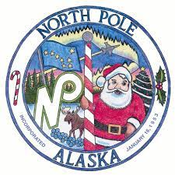
Local Leadership Update
City of North Pole Mayor’s Office
UNCLASSIFIED

Slide 37
Local Leadership Update
City of Fairbanks Mayor’s Office
UNCLASSIFIED

Slide 38
Open Discussion
Alaska Department of Law
Doyon Ltd.
Doyon Utilities
Fairbanks Economic Development Corporation
Golden Valley Electric Association (GVEA)
Northern Alaska Environmental Center
Regulatory Commission of Alaska
University of Alaska (UAF), Alaska Center for Energy and Power
U.S. Army Garrison Alaska - Fort Wainwright
Usibelli Coal Mine
UNCLASSIFIED

Slide 39
Closing remarks
Ms. Nancy Balkus
Deputy Assistant Secretary of the Air Force
(Infrastructure, Energy, and Environment)
UNCLASSIFIED

Slide 40
Contact Information
Contact with any questions, comments, or concerns:
Ms. Ashley Sadorra, SAF/IEE CTR
(ashley.sadorra.1.ctr@us.af.mil)
Micro-reactor Website
(https://www.eielson.af.mil/microreactor/)
Micro-reactor Org Box:
(SAF.IEE.Micro-ReactorPilot@us.af.mil)
Ms. Corey Chance, SAF/IEE
(corey.chance.2@us.af.mil)
Ms. Judith Willis, SAF/IEE
(judith.willis@us.af.mil)
UNCLASSIFIED

Slide 41
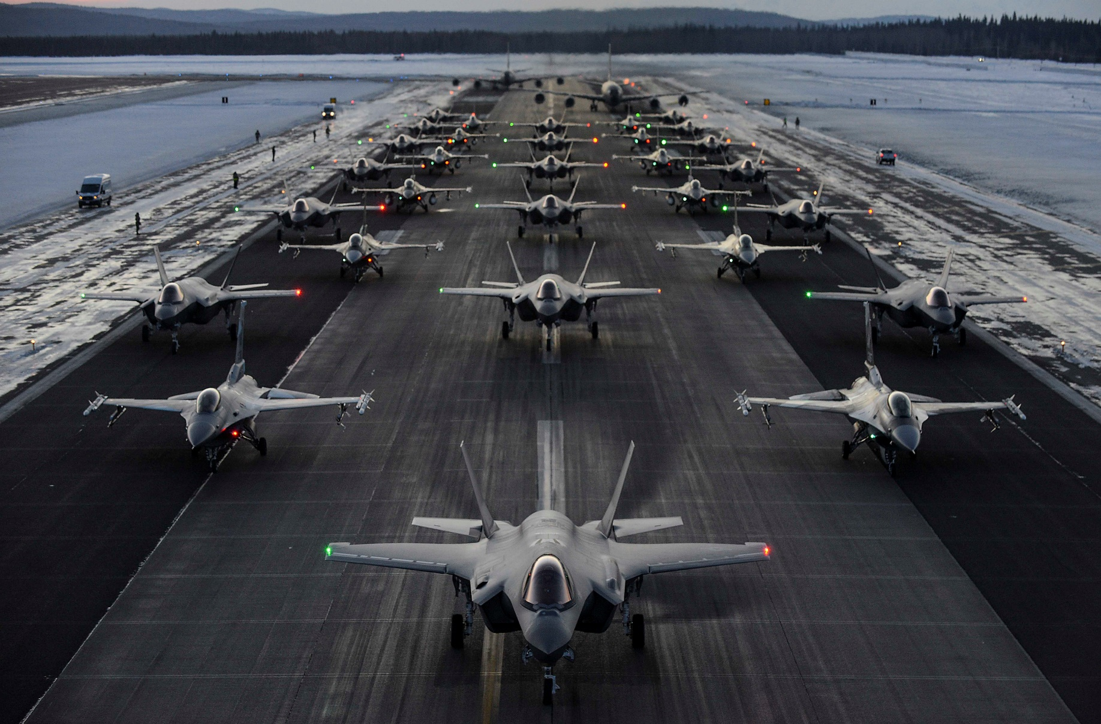
Thank You!
UNCLASSIFIED

Slide 42
Backup slides
UNCLASSIFIED

Slide 43
Current Timeline
SEP 2020
OCT 2021
AUG 2022
OCT 2022
JAN 2023
AUG 2023
2025
Request for Information (RFI) Release
DLA released initial RFI in advance of the acquisition.
Preferred Location Announced
DAF announced Eielson AFB as the preferred location to pilot its first micro-reactor.
Federal Partnership Established
DAF co-signed a Memorandum of Understanding with critical project partners.
First CAMP Meeting
DAF hosted the first quarterly Council for the Alaska Micro-reactor Program meeting in Alaska.
RFP Closed
DAF Selects Owner/Operator
DAF issued the Notice of Intent to Award for a micro-reactor facility at Eielson AFB.
Vendor Selection &
Pre-Licensing Process Initiated
Project planning to inform siting and environmental activities begins.
SEP 2023-
Present
JUL 2018
JAN 2021
OCT 2021
SEP 2022
OCT 2022
AUG 2023
FY2019 NDAA
Required the Secretary of Energy to provide a report on a micro-reactor pilot program by December 31, 2027.
EO 13972
The Executive Order directed demonstration of a micro-reactor at a domestic military installation.
Initiated Community Outreach
DAF sent letters to notify Tribal Nations and local government leadership.
Request for Proposal (RFP) Released
DLA released RFP.
DAF Climate Action Plan Released
The plan included the micro-reactor pilot program as a Key Result.
Public Town Hall
The inaugural town hall included a panel of speakers from DAF, NRC, and INL, and was moderated by University of Alaska-Fairbanks.
Acquisition in proposal review process following a bid protest. The protest was dismissed by the Government Accountability Office in Apr 2024.
BLUE: Procurement Actions GREEN: Policy Drivers
PURPLE: Partner and Stakeholder Engagement PINK: Licensing, Siting, and Operation

Slide 44
Communication Methods, Tools & Frequency
Communication Tool | Frequency | Purpose
Eielson Micro-reactor Webpage | Ongoing | Streamline dissemination of up-to-date information in an accessible format
Council for the Alaska Micro-reactor Program (CAMP) Meetings | Ongoing | Provide timely and transparent information and updates for key stakeholders Strengthen stakeholder coordination and relationships
Town Hall | As Needed | Connect with and inform a wider stakeholder audience about the Eielson pilot and advanced nuclear energy technology
Newsletter | Quarterly | Immediate and real-time delivery of important project updates
External Publications | As Needed | Ensure widest dissemination of information to expand audience and message accessibility
UNCLASSIFIED

Slide 45
DAF Advanced Nuclear Energy Program
BLUF: DAF is exploring advanced nuclear energy capabilities to support its mission-critical infrastructure through several ongoing efforts
Micro-reactor Pilot at Eielson AFB explores aspects related to future deployments including procurement, leasing, contracting, siting, licensing, safety review, environmental review, and tribal and public engagement
Pacific Northwest National Laboratories partnership developed roadmaps to outline decision-making processes and supports regulatory, siting, and community engagement activities
AFWERX simulation of Radiant Industries' Kaleidos micro-reactor at Hill AFB demonstrates adoption of nuclear energy into installation power grids
DoD Advanced Reactor Criteria and Baseline Understanding for Enterprise Scalability (DARC BLUES) seeks to implement robust siting criteria and data-driven decision-making tool with vertical governance to scale advanced nuclear energy technology across the Department
DAF partnered in Defense Innovation Unit Advanced Nuclear Power for Installations to explore full-lifecycle nuclear energy generation across viable sites
Notes:
The Department of the Air Force is laying the groundwork for a transformative approach through the ongoing pilot, studies, and is in the process of developing a framework with detailed criteria for implementing advanced nuclear reactor technology across the Department.
The DAF micro-reactor pilot program at Eielson Air Force Base will be the first deployment of a commercial micro-reactor on DoD property and is a pathfinder for Enterprise application of advanced nuclear energy systems, as directed by Section 327 of the Fiscal Year 2019 National Defense Authorization Act. Throughout the pilot, the DAF must assess mission compatibility with advanced nuclear energy technology at additional Enterprise locations, to include siting, environmental, and acquisition criteria, to inform the future policy and viability of scale. Efforts in this pilot program concerning data gathering, analyses, and technology and operations timeframes will inform and validate assumptions for this wider scalability framework, ensuring a repeatable process for the Enterprise.
The DAF partnered with Pacific Northwest National Laboratory to evaluate road maps and methodologies for siting microreactors for operation on Air Force Bases, as an understanding is needed of current regulations and challenges as they apply to microreactors and the National Environmental Policy Act (NEPA).
There is an ongoing RDT&E effort through AFWERX SBIR. Radiant Industries’s is conducting Kaleidos micro-reactor modeling and simulation efforts at Hill AFB. This R&D effort seeks to directly improve mission readiness and enhance installation and enterprise energy resiliency through the implementation of Kaleidos micro-reactors. The Kaleidos is Radiant Industries' advanced nuclear microreactor optimized for military applications. The Kaleidos micro-reactor is PROPOSED to provide resilient, carbon-free energy generation for extended durations (4-6 years) without refueling. The Kaleidos micro-reactor is also proposed to be tested at Idaho National Laboratory in the near future.
Our internal IEE team is seeking to identify and create advanced reactor criteria and data system of record by evaluating robust data and information such as, but not limited to, safety and environmental requirements, public health, institutional requirements, regulatory permitting and licensing requirements, socioeconomic and environmental justice factors, data and cyber security requirements, land use, geology and seismology, atmospheric dispersion, climate, transportation, international and host nation regulatory requirements, market costs, fuel requirements, community interest, military mission requirements, mission compatibility, all-hazards response, and emergency preparedness. We have a proposal put forward for the FY25 Operational Energy Innovation Office OECIF call and are awaiting more details to push forward with this study.
Additionally, the DAF is participating within the DIU Advanced Nuclear Power for Installation Project, which is an open commercial nuclear micro-reactor prototype capability to power US Army and DAF bases. The request for information seeks a new, full-lifecycle power plant that will generate and distribute electricity across in-country army sites by the end of the decade. All data associated with this effort will be leveraged and incorporated into the DAF advanced reactor framework.
Next, we’ll discuss the DAF Micro-reactor Pilot in detail.

